Slide 1


Introduce Yourself

Slide 2



I AM…
Adaptable
Open-minded
Patient
Sensitive

Slide 3



SWOT
01.
02.
Strength
Weakness
03.
04.
Opportunities
Threats
Quick learner in new environments
Limited technical skills in a specific area
Freelance and contract work
General Knowledge

Slide 4





I LOVE..
Mandala Art | Yoga
Reading Books | Travel
Perfumery Art

Slide 5


I HATE..
Unfairness
Negativity
Gossip
Arrogance

Slide 6
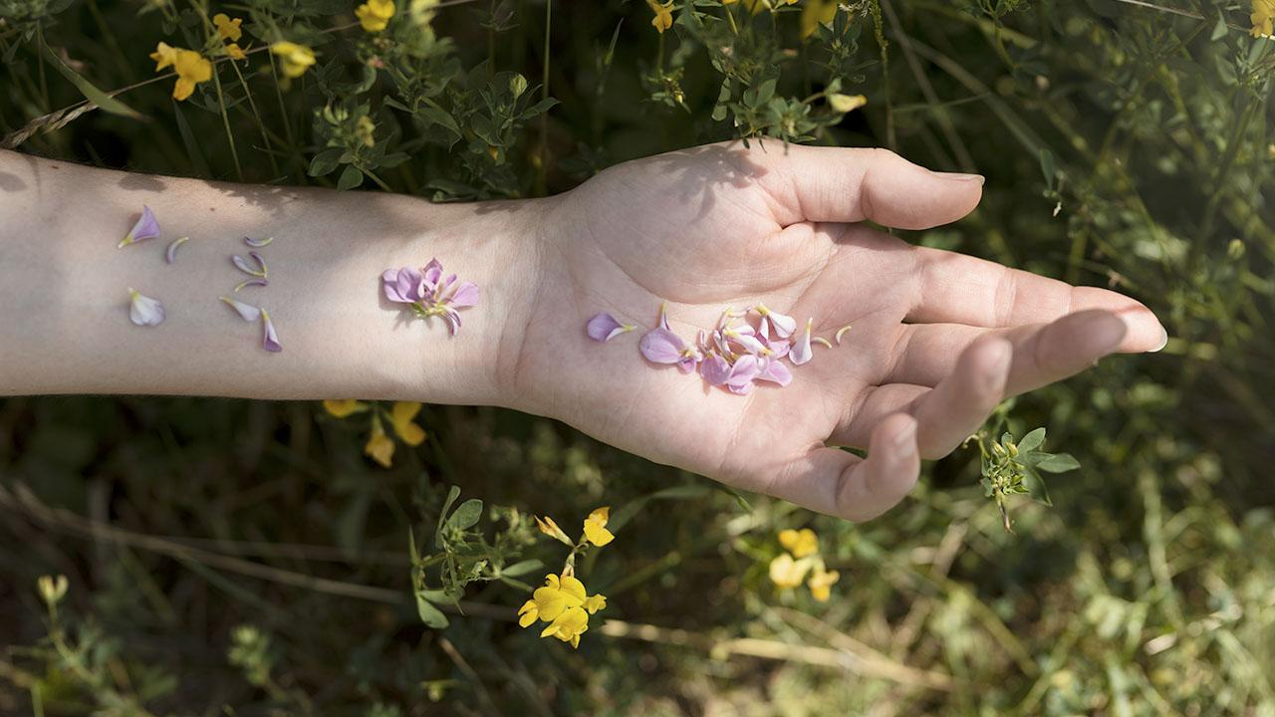
It always seems impossible until it’s done.

Slide 7
Thank You!

